Slide 1
Name: Amr Hossam Mohamed Younes
Internship
Final Project

Slide 2
AGENDA
Project Overview
System Architecture
Testbenches
Bitstream Generation for FPGA

Slide 3
Project Overview

Slide 4

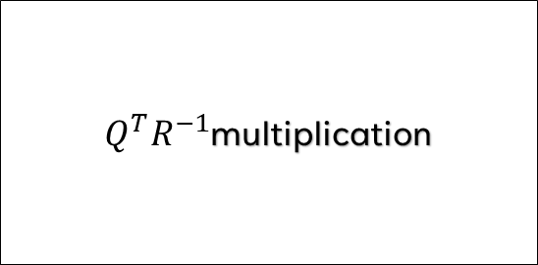





Matrix 3x3 inversion using QR decomposition
QR decomposition
$$R$$
Simple matrix inversion
$$R^{−1}$$
$Q^{T}R^{−1}$multiplication
$$A$$
$$A^{−1}$$
$$Q$$
Simple matrix transpose
$$Q^{T}$$

Slide 5
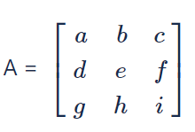
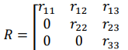
Matric 3x3 inversion using QR decomposition
Pivot Selection:
Start with the element a as the pivot. We want to nullify the element d below it.
CORDIC Vectoring for a and d:
Use a and d as inputs to the vectoring CORDIC algorithm.
This will result in a new value a′ and an angle θ1​.
CORDIC Rotation for Other Elements:
Step 1: Apply θ1​ to b and e using rotational CORDIC, resulting in b′ and e′.
Step 2: Apply θ1​ to c and f using rotational CORDIC, resulting in c′ and f′.

Slide 6
Matric 3x3 inversion using QR decomposition
4.Update Matrix:
The element d is now nulled in the R-matrix, and the other elements a′, b′, c′, e′, f′ are updated accordingly.
5.Repeat Process for Lower Rows:
Perform the same operation on the elements g and h and updating their corresponding rows using rotational CORDIC.
6.Resulting Matrix:
After completing these operations, the matrix transforms into the upper triangular R matrix.
The angles θ obtained at each step are used to construct the orthogonal matrix Q.

Slide 7
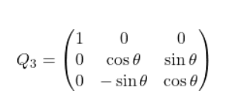
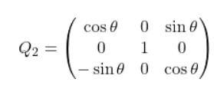
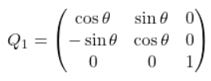
Matric 3x3 inversion using QR decomposition
7.Optainig Q by multiply Q1, Q2, Q3 To get Q
8.Get R inverse and Q transpose multiply them together and you will get A inverse

Slide 8
System Architecture

Slide 9
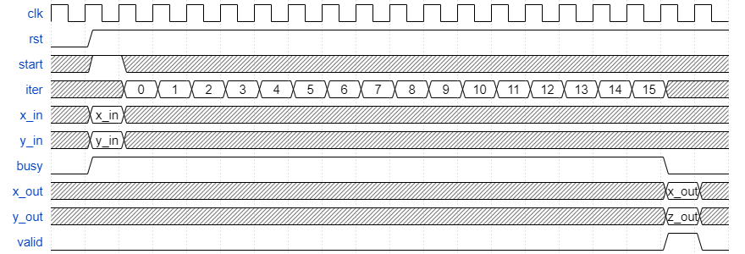
System Architecture
Cordic Vectoring
The CORDIC vectoring algorithm takes two inputs, x and y, and performs the following:
It aims to rotate the vector (x, y) such that the output y′ becomes zero.
The output consists of the new x value, after the necessary rotations, along with the angle θ used for the rotation.

Slide 10
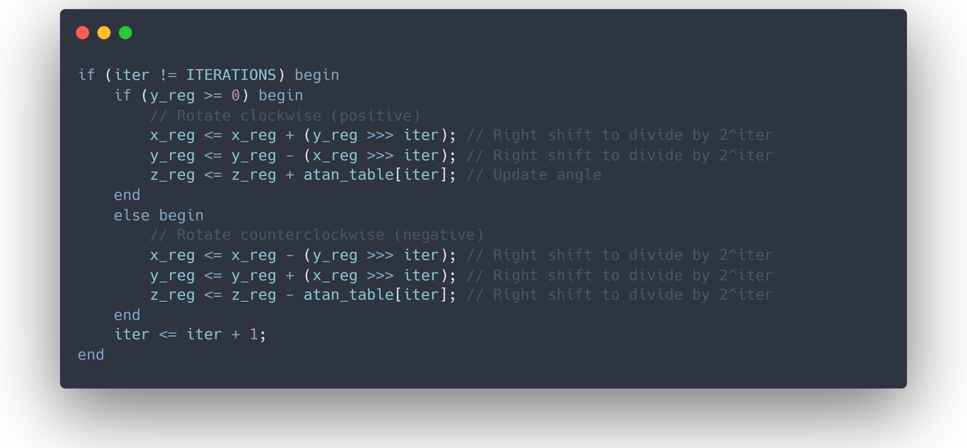
System Architecture
Cordic Vectoring

Slide 11
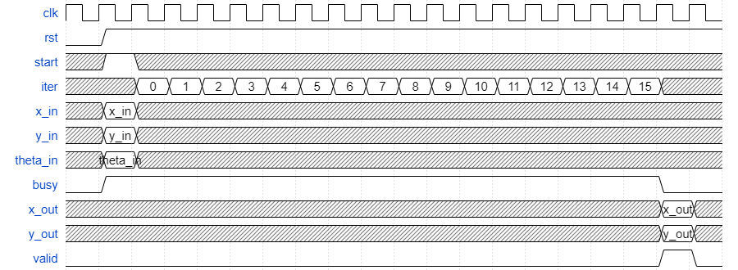
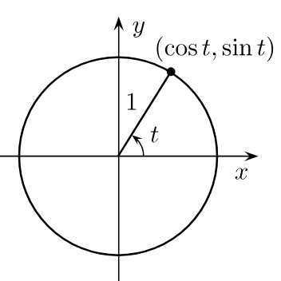
System Architecture
Cordic Rotational
It aims to rotate the vector (x, y) with angle θ.
The output consists of the new x value and new y value after the necessary rotations, along with the angle θ used for the rotation.

Slide 12
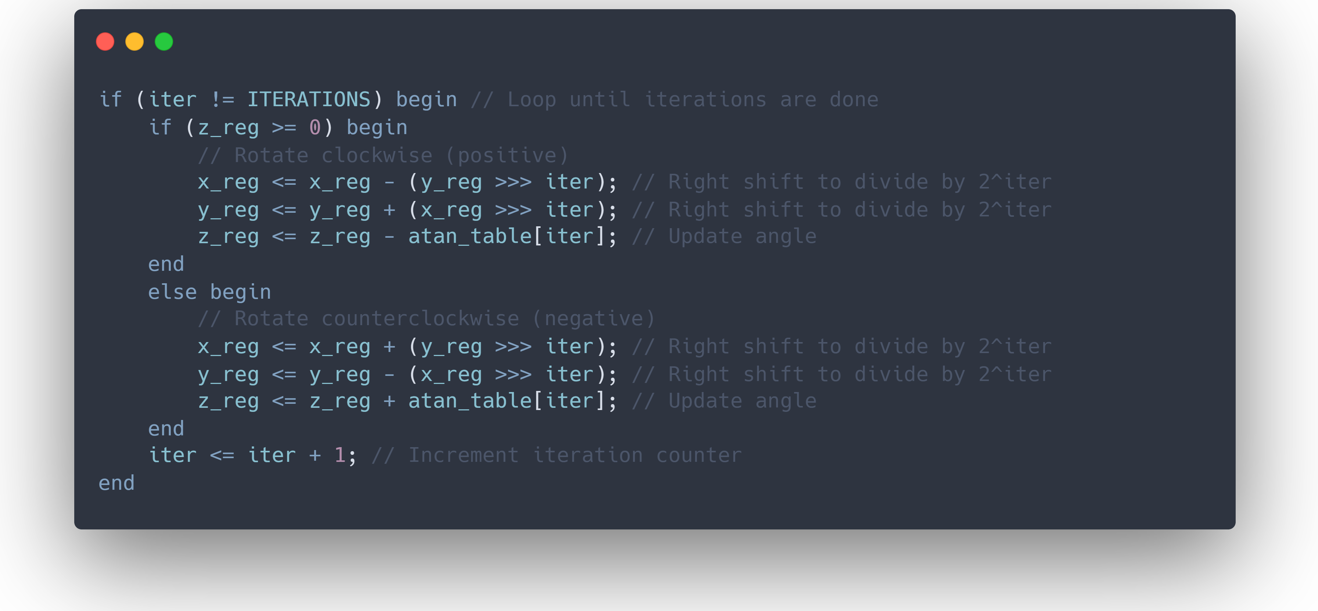
System Architecture
Cordic Rotational

Slide 13
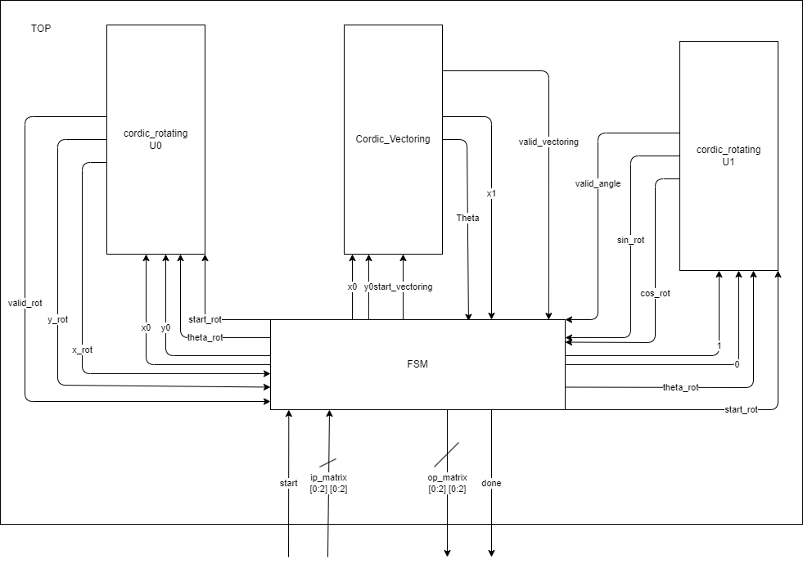
System Architecture

Slide 14
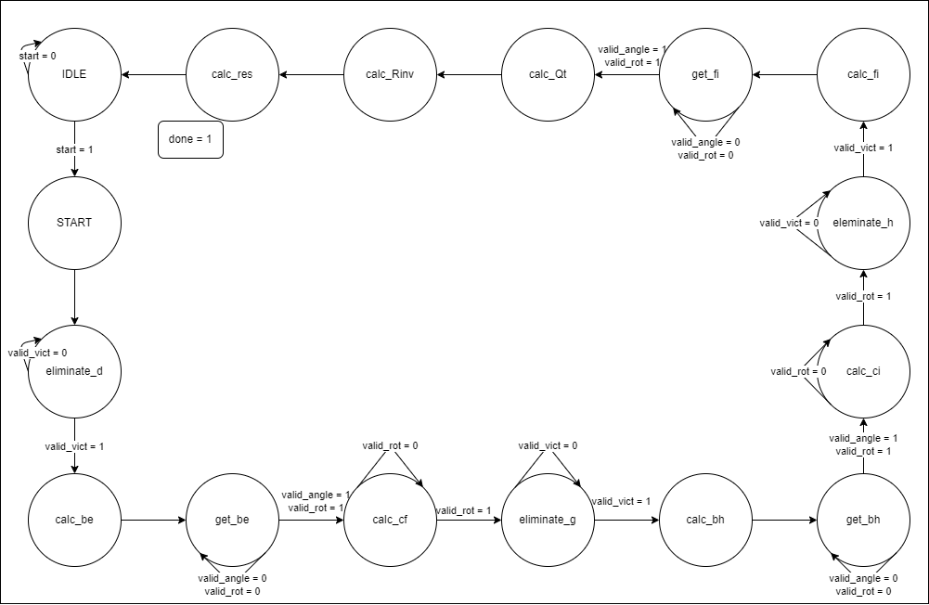
System Architecture
FSM

Slide 15
Testbenches

Slide 16
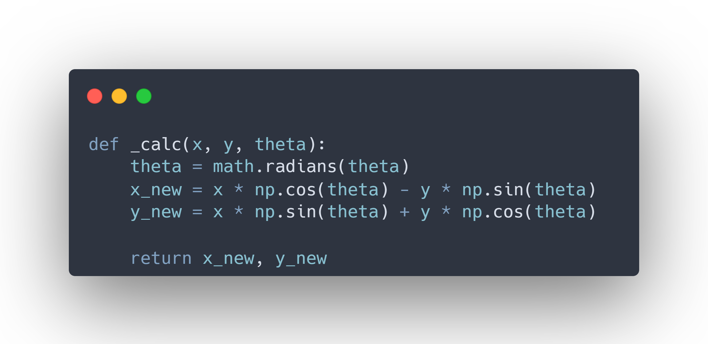
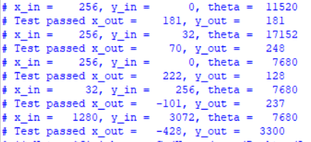
Testbenches
CORDIC Rotational Module
testbench verifies the functionality of the CORDIC rotational module by calculating the expected outputs (rotated coordinates) using a Python and give it to the testbench.

Slide 17
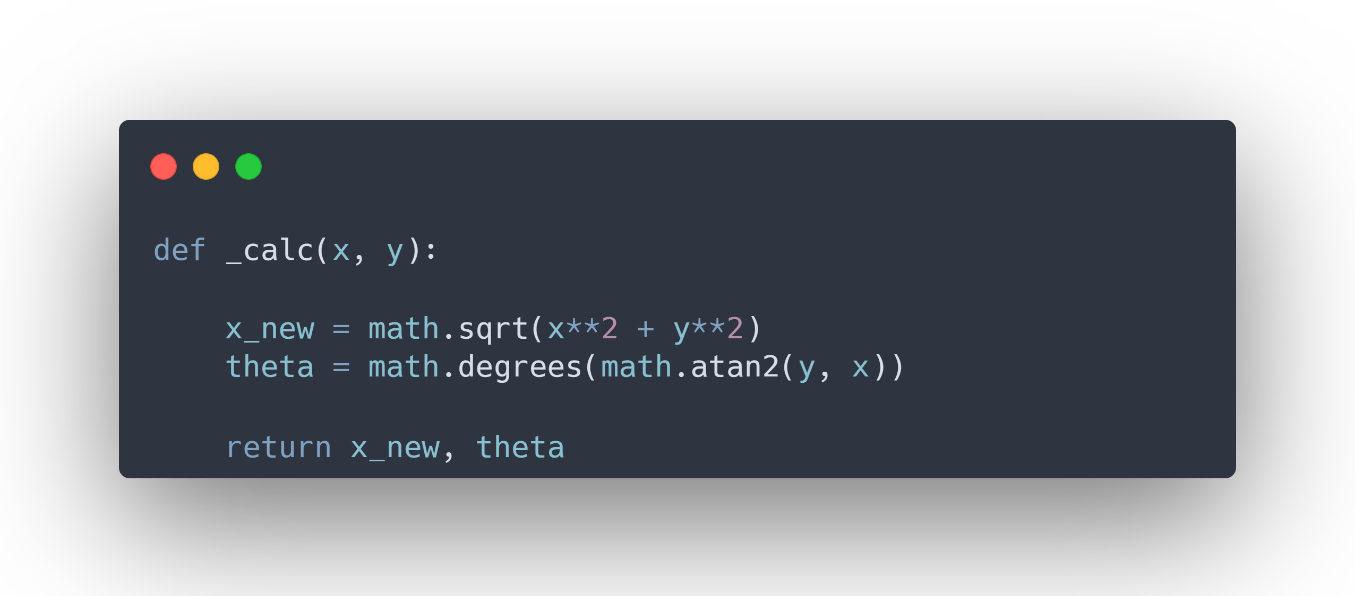
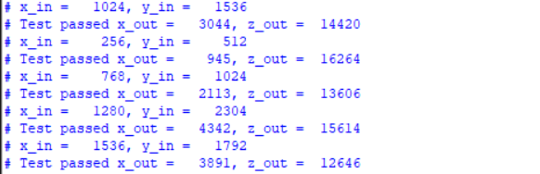
Testbenches
CORDIC Vectoring Module
testbench verifies the functionality of the CORDIC Vectoring module by calculating the expected magnitude and angle using a Python and give it to the testbench.

Slide 18
Testbenches
Top Module
Inputs are provided, and the expected outputs are calculated using an online tool, such as the matrix calculator, for validation.

Slide 19
Bitstream Generation for FPGA

Slide 20
Bitstream Generation for FPGA
Target Frequency: 150 MHz
Target Board: Zynq UltraScale+ MPSoC ZCU104 Evaluation Kit
Successfully generated the bitstream for the ZCU104 board to meet the 150 MHz design target.
Total chip power: 0.592 W

Slide 21
THANK YOU

